Slide 1
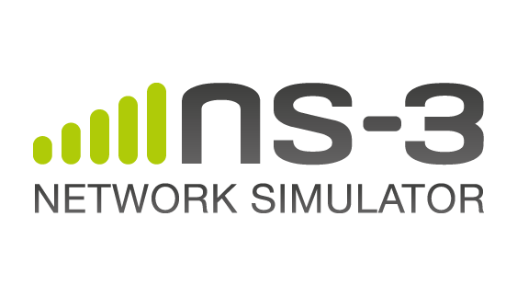

Introduction to NS-3 Part - 1
Katsaros Konstantinos
PhD Student
PGSDP Workshop on NS-3
26 March 2012

Slide 2


Overview
NS3 Vs. NS2
NS3 Features
Download – Build – Use
Current Modules
Simulation Basics
Abstractions – Simple example walkthrough
Attributes
Tracing
Callbacks
Examples-Lab
Resources
Konstantinos Katsaros
2

Slide 3
NS3 Vs. NS2
ns-2 uses OTcl as its scripting environment
ns-3 uses C++ programs or python scripts to define simulations.
simulation programs are C++ executables or Python programs
Python is often a glue language, in practice
ns-3 is a GNU GPLv2-licensed project
ns-3 is not backwards-compatible with ns-2
Some ns-2 models that are mostly written in C++ have already been ported to ns-3. OTcl-based models can not be ported “as is”. Need to re-write.
Konstantinos Katsaros
3

Slide 4
NS3 Features (1)
Scalability features
Packets can have ”virtual zero bytes” (or dummy bytes)
For dummy application data that we don't care about
No memory is allocated for virtual zero bytes
Reduces the memory footprint of the simulation
Nodes have optional features (sort of AOP)
No memory waste in IPv4 stack for nodes that don't need it
Mobility model may not be needed
E.g. wired netdevices do not need to know the node position at all
New features can be easily added in the future
For example, energy models
Cross-layer features
Packet Tags
Small units of information attached to packets
Tracing
Allow to report events across non-contiguous layers
Konstantinos Katsaros
4

Slide 5
NS3 Features (2)
Real world integration features
Packets can be saved to PCAP files, in a real format
Many tools can read PCAP files, e.g. Wireshark
Real-time scheduler
Simulation events synchronized to ”wall clock time”
”Network Simulation Cradle”
Run Linux Kernel TCP/IP stack under simulation
Linux 2.6.18, Linux 2.6.26
POSIX Emulation (experimental)
Run unmodified POSIX programs under simulation
Special ELF loader converts POSIX API calls into NS-3 calls
Running routing daemons on NS-3 (planned)
Konstantinos Katsaros
5

Slide 6
Download - Install - Use
Cross platform (limited support for Win)
First download & install ALL dependencies
Simple download and build project…
Current stable version ns-3.13
Run example!!
http://www.nsnam.org/wiki/index.php/Installation
Konstantinos Katsaros
6

Slide 7
Current Modules
aodv | applications | bridge
click | config-store | core
csma | csma-layout | dsdv
emu | energy | flow-monitor
internet | lte | mesh
mobility | mpi | netanim
network | nix-vector-routing | olsr
openflow | point-to-point | point-to-point-layout
propagation | spectrum | stats
tap-bridge | test | tools
topology-read | uan | virtual-net-device
visualizer | wifi | wimax
http://www.nsnam.org/docs/release/3.13/models/ns-3-model-library.pdf
Konstantinos Katsaros
7

Slide 8
Simulation Basics
Simulation time moves in discrete jumps from event to event
C++ functions schedule events to occur at specific simulation times
A simulation scheduler orders the event execution
Simulation::Run() gets it all started
Simulation stops at specific time or when events end
Konstantinos Katsaros
8

Slide 9
Abstractions
Node
Application
Channel
NetDevice
Packet
Topology Helpers – aggregate functionality of modules to make common operations easier than using the low-level API
Consists of:
container objects
helper classes
Konstantinos Katsaros
9

Slide 10
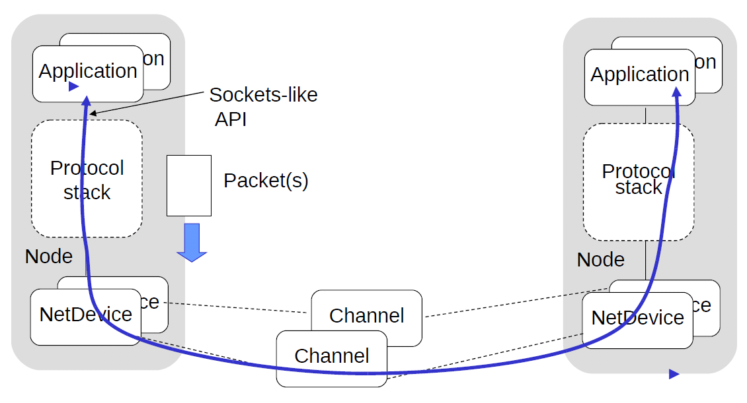
Example - conceptual
Konstantinos Katsaros
10

Slide 11
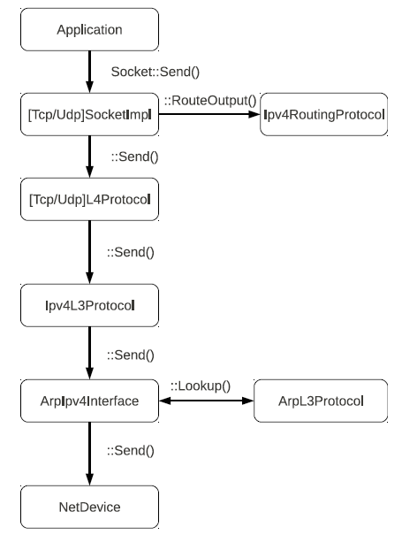
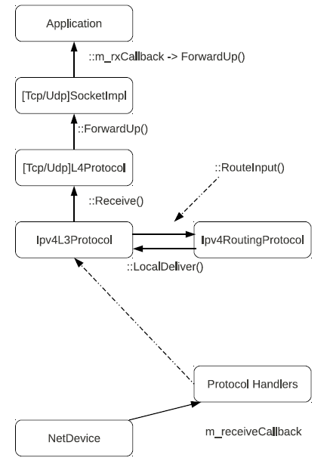
Example – ns3 implemented
Protocol Stack
Node
Konstantinos Katsaros
11

Slide 12
Example Script - 1
/* -*- Mode:C++; c-file-style:"gnu"; indent-tabs-mode:nil; -*- */
// GPLv2 Licence …
#include "ns3/core-module.h"
#include "ns3/network-module.h"
#include "ns3/internet-module.h"
#include "ns3/point-to-point-module.h"
#include "ns3/applications-module.h"
using namespace ns3;
NS_LOG_COMPONENT_DEFINE ("FirstScriptExample");
int main (int argc, char *argv[])
{
LogComponentEnable ("UdpEchoClientApplication", LOG_LEVEL_INFO);
LogComponentEnable ("UdpEchoServerApplication", LOG_LEVEL_INFO);
NodeContainer nodes;
nodes.Create (2);
PointToPointHelper pointToPoint;
pointToPoint.SetDeviceAttribute ("DataRate", StringValue ("5Mbps"));
pointToPoint.SetChannelAttribute ("Delay", StringValue ("2ms"));
NetDeviceContainer devices;
devices = pointToPoint.Install (nodes);
include modules that will be used
ns-3 project namespace
enable and disable console message logging by reference to the name
Topology Configuration
Konstantinos Katsaros
12

Slide 13
Example Script - 2
InternetStackHelper stack;
stack.Install (nodes);
Ipv4AddressHelper address;
address.SetBase ("10.1.1.0", "255.255.255.0");
Ipv4InterfaceContainer interfaces = address.Assign (devices);
UdpEchoServerHelper echoServer (9);
ApplicationContainer serverApps = echoServer.Install (nodes.Get (1));
serverApps.Start (Seconds (1.0));
serverApps.Stop (Seconds (10.0));
UdpEchoClientHelper echoClient (interfaces.GetAddress (1), 9);
echoClient.SetAttribute ("MaxPackets", UintegerValue (1));
echoClient.SetAttribute ("Interval", TimeValue (Seconds (1.0)));
echoClient.SetAttribute ("PacketSize", UintegerValue (1024));
ApplicationContainer clientApps = echoClient.Install (nodes.Get (0));
clientApps.Start (Seconds (2.0));
clientApps.Stop (Seconds (10.0));
Simulator::Run ();
Simulator::Destroy ();
return 0;
}
Set up internet stack
Set up applications
Run the simulation
Konstantinos Katsaros
13

Slide 14
Running Example
ALL SCENARIOS SHOULD BE RUN UNDER SCRATCH
% cp examples/tutorial/first.cc scratch/myfirst.cc
% ./waf
% ./waf --run /scratch/myfirst
% Waf: Entering directory ‘/scratch/ns3-workshop/ns-allinone-3.13/ns-3.13/build’
Waf: Leaving directory ‘/scratch/ns3-workshop/ns-allinone-3.13/ns-3.13/build’
’build’ finished successfully (1.218s)
Sent 1024 bytes to 10.1.1.2
Received 1024 bytes from 10.1.1.1
Received 1024 bytes from 10.1.1.2
Konstantinos Katsaros
14

Slide 15
Attributes
Problem: Researchers want to identify all of the values affecting the results of their simulations and configure them easily
ns-3 solution: Each ns-3 object has a set of attributes:
A name, help text
A type
An initial value
Control all simulation parameters for static objects
Dump and read them all in configuration files
Visualize them in a GUI
Makes it easy to verify the parameters of a simulation
Konstantinos Katsaros
15

Slide 16
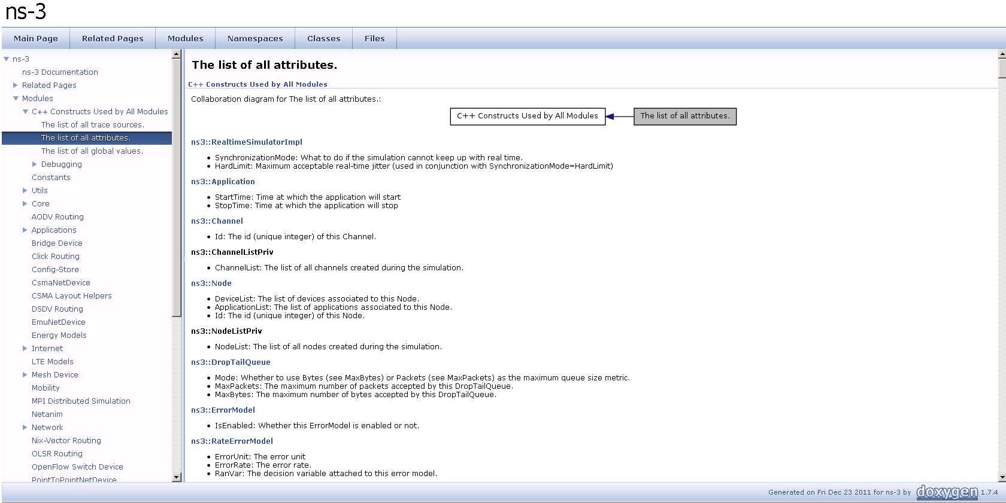
Attributes
http://www.nsnam.org/docs/release/3.13/doxygen/group___attribute_list.html
Konstantinos Katsaros
16

Slide 17
Attributes
An Attribute represents a value in our system
An Attribute can be connected to an underlying variable or function
– e.g., TcpSocket::m_cwnd;
– or a trace source
Konstantinos Katsaros
17

Slide 18
How to handle attributes
The traditional C++ way:
export attributes as part of a class's public API
walk pointer chains (and iterators, when needed) to find what you need
use static variables for defaults
The attribute system provides a more convenient API to the user to do these things
Konstantinos Katsaros
18

Slide 19
Navigating the attributes
Attributes are exported into a string-based namespace, with filesystem-like paths
namespace supports regular expressions
Attributes also can be used without the paths
e.g., “ns3::WifiPhy::TxGain”
A Config class allows users to manipulate the attributes
Konstantinos Katsaros
19

Slide 20
Fine-grained attribute handling
Set or get the current value of a variable
Here, one needs the path in the namespace to the right instance of the object
Config::SetAttribute(“/NodeList/5/DeviceList/3/Phy/TxGain”, DoubleValue(1.0));
DoubleValue d;
nodePtr->GetAttribute (“/NodeList/5/NetDevice/3/Phy/TxGain”, d);
Users can get Ptrs to instances also, and Ptrs to trace sources, in the same way
Konstantinos Katsaros
20

Slide 21
How to manipulate attributes
Individual object attributes often derive from default values
Setting the default value will affect all subsequently created objects
Ability to configure attributes on a per-object basis
Set the default value of an attribute from the command-line:
CommandLine cmd;
cmd.Parse (argc, argv);
Set the default value of an attribute with NS_ATTRIBUTE_DEFAULT
Set the default value of an attribute in C++:
Config::SetDefault ("ns3::Ipv4L3Protocol::CalcChecksum", BooleanValue (true));
Set an attribute directly on a specic object:
Ptr<CsmaChannel> csmaChannel = ...;
csmaChannel->SetAttribute ("DataRate",
StringValue ("5Mbps"));
Konstantinos Katsaros
21

Slide 22
Tracing System
Simulator provides a set of pre-configured trace sources
Users may edit the core to add their own
Users provide trace sinks and attach to the trace source
Simulator core provides a few examples for common cases
Multiple trace sources can connect to a trace sink
Konstantinos Katsaros
22

Slide 23
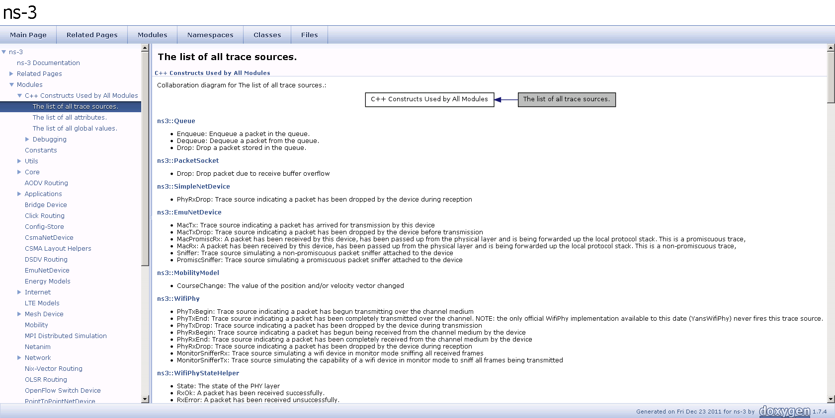
Trace Sources
http://www.nsnam.org/docs/release/3.13/doxygen/group___trace_source_list.html
Konstantinos Katsaros
23

Slide 24
Basic Tracing
Helper classes hide the tracing details from the user, for simple trace types
ascii or pcap traces of devices
std::ofstream ascii;
ascii.open ("wns3-helper.tr");
CsmaHelper::EnableAsciiAll (ascii);
CsmaHelper::EnablePcapAll ("wns3-helper");
YansWifiPhyHelper::EnablePcapAll ("wsn3-helper");
Konstantinos Katsaros
24

Slide 25
Multiple Levels of Tracing
Highest-level: Use built-in trace sources and sinks and hook a trace file to them
Mid-level: Customize trace source/sink behaviour using the tracing namespace
Low-level: Add trace sources to the tracing namespace
Konstantinos Katsaros
25

Slide 26
Highest Level of Tracing
Highest-level: Use built-in trace sources and sinks and hook a trace file to them
// Also configure some tcpdump traces; each interface // will be traced.
// The output files will be named:
// simple-point-to-point.pcap-<nodeId>-<interfaceId>
// and can be read by the "tcpdump -r" command (use "-// tt" option to display timestamps correctly)
PcapTrace pcaptrace ("simple-point-to-point.pcap");
pcaptrace.TraceAllIp ();
Konstantinos Katsaros
26

Slide 27
Mid Level of Tracing
Mid-level: Customize trace source/sink behaviour using the tracing namespace
void
PcapTrace::TraceAllIp (void)
{
NodeList::Connect ("/nodes/*/ipv4/(tx|rx)",
MakeCallback (&PcapTrace::LogIp, this));
}
Regular expression editing
Hook in a different trace sink
Konstantinos Katsaros
27

Slide 28
Low Level of Tracing
Low-level: Add trace sources to the tracing namespace
Config::Connect ("/NodeList/.../Source",
MakeCallback (&ConfigTest::ChangeNotification, this));
Konstantinos Katsaros
28

Slide 29
Callbacks
ns-3 Callback class implements function objects
Type safe callbacks, manipulated by value
Used for example in sockets and tracing
Example
Class MyClass {
public:
double MyFunc (int x, float y) {
return double (x + y) / 2;
}
[...]
Callback<double, int, float> cb1;
MyClass myobj;
cb1 = MakeCallback(&MyClass::MyFunc, &myobj);
double result = cb1 (2,3); // result receives 2.5
Konstantinos Katsaros
29

Slide 30
Lab 1: Simple Client/Server
Level: Introductory
Expected learning outcome: NS-3 simulation basics. Basic client server paradigm. Reading pcap traces.
Experiment:
Create a simple topology of two nodes (Node1, Node2) separated by a point-to-point link.
Setup a UdpClient on one Node1 and a UdpServer on Node2. Let it be of a fixed data rate Rate1.
Start the client application, and measure end to end throughput whilst varying the latency of the link.
Now add another client application to Node1 and a server instance to Node2. What do you need to configure to ensure that there is no conflict?
Repeat step 3 with the extra client and server application instances. Show screenshots of pcap traces which indicate that delivery is made to the appropriate server instance.
Konstantinos Katsaros
30

Slide 31
Lab 2: TCP Variants
Level: Introductory
Expected learning outcome: TCP internals and the difference between each of the variants. NS-3 tracing mechanism.
Experiment:
Create a simple dumbbell topology, two client Node1 and Node2 on the left side of the dumbbell and server nodes Node3 and Node4 on the right side of the dumbbell. Let Node5 and Node6 form the bridge of the dumbbell. Use point to point links.
Install a TCP socket instance on Node1 that will connect to Node3.
Install a UDP socket instance on Node2 that will connect to Node4.
Start the TCP application at time 1s.
Start the UDP application at time 20s at rate Rate1 such that it clogs half the dumbbell bridge's link capacity.
Increase the UDP application's rate at time 30s to rate Rate2 such that it clogs the whole of the dumbbell bridge's capacity.
Use the ns-3 tracing mechanism to record changes in congestion window size of the TCP instance over time. Use gnuplot/matplotlib to visualise plots of cwnd vs time.
Mark points of fast recovery and slow start in the graphs.
Perform the above experiment for TCP variants Tahoe, Reno and New Reno, all of which are available with ns-3
Konstantinos Katsaros
31

Slide 32
Lab 3: TCP and Router Queues
Level: Introductory
Expected learning outcome: Queues, packet drops and their effect on congestion window size.
Experiment:
As in previous exercise, Create a simple dumbbell topology, two client Node1 and Node2 on the left side of the dumbbell and server nodes Node3 and Node4 on the right side of the dumbbell. Let Node5 and Node6 form the bridge of the dumbbell. Use point to point links.
Add drop tail queues of size QueueSize5 and QueueSize6 to Node5 and Node6, respectively.
Install a TCP socket instance on Node1 that will connect to Node3.
Install a TCP socket instance on Node2 that will connect to Node3.
Install a TCP socket instance on Node2 that will connect to Node4.
Start Node1--Node3 flow at time 1s, then measure it's throughput. How long does it take to fill link's entire capacity?
Start Node2--Node3 and Node2--Node4 flows at time 15s, measure their throughput.
Measure packet loss and cwnd size, and plot graphs throughput/time, cwnd/time and packet loss/time for each of the flows.
Plot graph throughput/cwnd and packet loss/cwnd for the first flow. Is there an optimal value for cwnd?
Vary QueueSize5 and QueueSize6. Which one has immediate effect on cwnd size of the first flow? Explain why.
Konstantinos Katsaros
32

Slide 33
Lab 4: OLSR routing
Level: Introductory
Expected learning outcome: What are MANETs and how they work. OLSR basics. Routing issues associated with MANETs.
Experiment:
Create a wireless mobile ad-hoc network with three nodes Node1, Node2 and Node3. Install the OLSR routing protocol on these nodes.
Place them such that Node1 and Node3 are just out of reach of each other.
Create a UDP client on Node1 and the corresponding server on Node3.
Schedule Node1 to begin sending packets to Node3 at time 1s.
Verify whether Node1 is able to send packets to Node3.
Make Node2 move between Node1 and Node3 such that Node2 is visible to both A and C. This should happen at time 20s. Ensure that Node2 stays in that position for another 15s.
Verify whether Node1 is able to send packets to Node3.
At time 35s, move Node2 out of the region between Node1 and Node3 such that it is out of each other's transmission ranges again.
Verify whether Node1 is able to send packets to Node3.
To verify whether data transmissions occur in the above scenarios, use either the tracing mechanism or a RecvCallback() for Node3's socket.
Plot the number of bytes received versus time at Node3.
Show the pcap traces at Node 2's Wifi interface, and indicate the correlation between Node2's packet reception timeline and Node2's mobility.
Konstantinos Katsaros
33

Slide 34
Lab 5: WiFi RTS/CTS
Level: Introductory
Expected learning outcome: How 802.11 works with and without RTS/CTS. An insight into why its hard to setup efficient wireless networks.
Experiment:
Setup a 5x5 wireless adhoc network with a grid. You may use examples/wireless/wifi-simple-adhoc-grid.cc as a base.
Install the OLSR routing protocol.
Setup three UDP traffic flows, one along each diagonal and one along the middle (at high rates of transmission).
Setup the ns-3 flow monitor for each of these flows.
Now schedule each of the flows at times 1s, 1.5s, and 2s.
Now using the flow monitor, observe the throughput of each of the UDP flows. Furthermore, use the tracing mechanism to monitor the number of packet collisions/drops at intermediary nodes. Around which nodes are most of the collisions/drops happening?
Now repeat the experiment with RTS/CTS enabled on the wifi devices.
Show the difference in throughput and packet drops if any.
Konstantinos Katsaros
34

Slide 35
Lab 6: WiFi Channels
Level: IntermediateInstall
Expected learning outcome: How Radio channel models affect transmission. An insight into why its important to correctly model the channel.
Experiment:
Setup a 2-nodes wireless adhoc network. Place the nodes at a fixed distance in a 3d scenario.
Install all the relevant network stacks, up to and including UDP.
Setup a CBR transmission between the nodes, one acting as a server and one as a client. Take the iperf [1] behaviour as an example.
Setup counters and outputs for packets sent and received.
Schedule the simulation to run for enough time to obtain statistically relevant results (suggestion: analyze some test results and reduce the simulation time accordingly).
Repeat the simulation varying the distance between the nodes from a minimum of 1meter to the point where the nodes can't transmit/receive anymore.
Repeat the above varying the channel models and the transmission/receive parameters like node's position above the ground, transmission power, etc.
Show the differences between the various channel models, and comment them. Identify the channel model that is more appropriate for each case (indoor, outdoor, LoS, NLoS, etc.).
[1] http://sourceforge.net/projects/iperf/
Konstantinos Katsaros
35

Slide 36
Resources
http://www.nsnam.org (main website)
http://www.nsnam.org/wiki/ (wiki)
http://code.nsnam.org/ (source repository)
http://groups.google.com/group/ns-3-users (google group)
ns-3-users@googlegroups.com (mailing list)
Konstantinos Katsaros
36

Slide 37
Acknowledgements
Special thanks to:
Mathieu Lacage
Tom Henderson
Gustavo Carneiro
For borrowing parts of their slides
Konstantinos Katsaros
37

Slide 38
Thank You!
Please fill the following survey after your first experience with NS-3
http://info.ee.surrey.ac.uk/Personal/K.Katsaros/ns-3-workshop-survey.html
Slides are available at:
http://info.ee.surrey.ac.uk/Personal/K.Katsaros/ns-3-workshop-part1.html
http://info.ee.surrey.ac.uk/Personal/K.Katsaros/ns-3-workshop-part2.html
Konstantinos Katsaros
38

